Slide 1



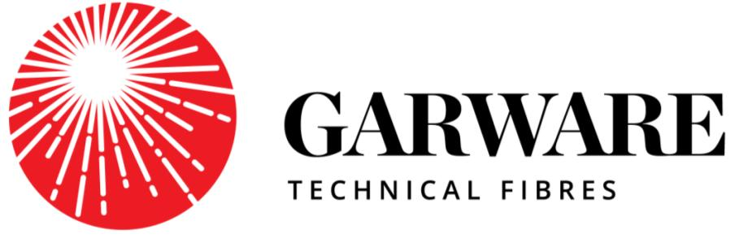
Better Ideas in Action
MOORING ROPES BASICS AND RECENT INNOVATIONS

Slide 2
Introduction to Ropes

Slide 3
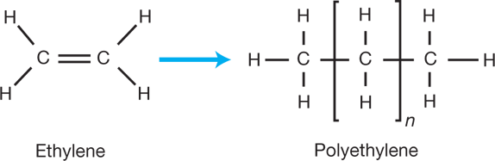
Introduction to Polymers
A polymer is a large molecule of which is formed by repeated linking of the small molecules called “Monomers”.
More monomer molecules joined in units of long polymer.
Single Ethylene Molecule
Addition of many single molecules
Polyethylene

Slide 4
Types of Polymers used for rope making
Polymer Materials used for rope making
High Density Polyethylene [HDPE]
Polypropylene [PP]
Polyester
Nylon
HMPE
Vectran
Aramids
Normal strength fibres
High Modulus fibres

Slide 5
Properties of different types of materials
Sr. No. | Material properties | High Density Polyethylene | Polypropylene | Polyester | Nylon
1 | Tensile strength [N/mm2] | 0.20 - 0.40 N/mm² | 0.95 - 1.30 N/mm² | 2.5 N/mm² | 0.90 – 1.85 N/mm²
2 | Density [g/cm3] | 0.944 - 0.965 g/cm3 | 0.905 g/cm3 | 1.37 g/cm3 | 1.13 - 1.35/1.41 g/cm3
3 | Elongation at break [%] | 11-20% | 12-15% | 11-14% | 17-24%
4 | Abrasion resistance | Good | Moderate | Very Good | Moderate
5 | Shrinkage | Resistant to shrinkage | Resistant to shrinkage | Moderately resistant to shrinkage | Prone to shrinkage
6 | Water absorption | Does not absorb water | Does not absorb water | Absorbs some water | Absorbs most water
7 | UV Resistance | Good | Moderate | Very good | Good
8 | Floating properties | Floating | Floating | Sinking | Sinking
9 | Creep | High creep | Moderate creep | Low creep | Low creep
10 | Fatigue resistance in wet condition | Moderate | Good | Good | Low

Slide 6
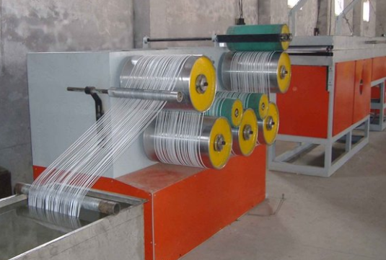
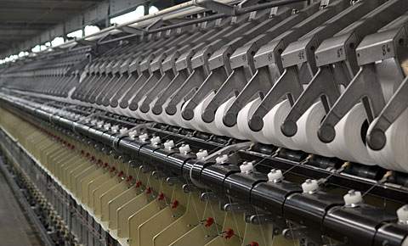
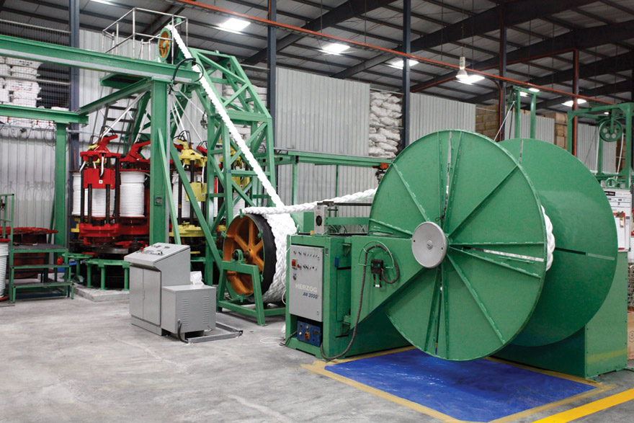
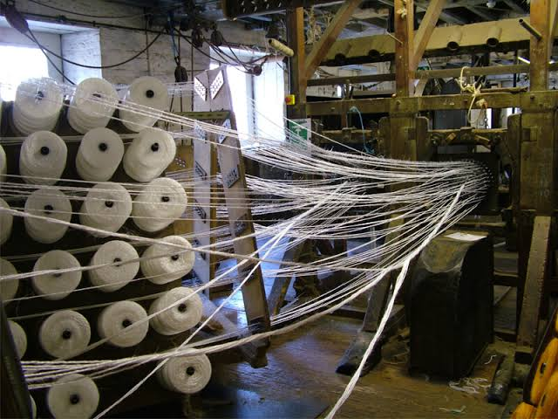
Rope Making process
Extrusion
Twisting
01
Rope Making
04
02
Rope Making
Strand making
03

Slide 7
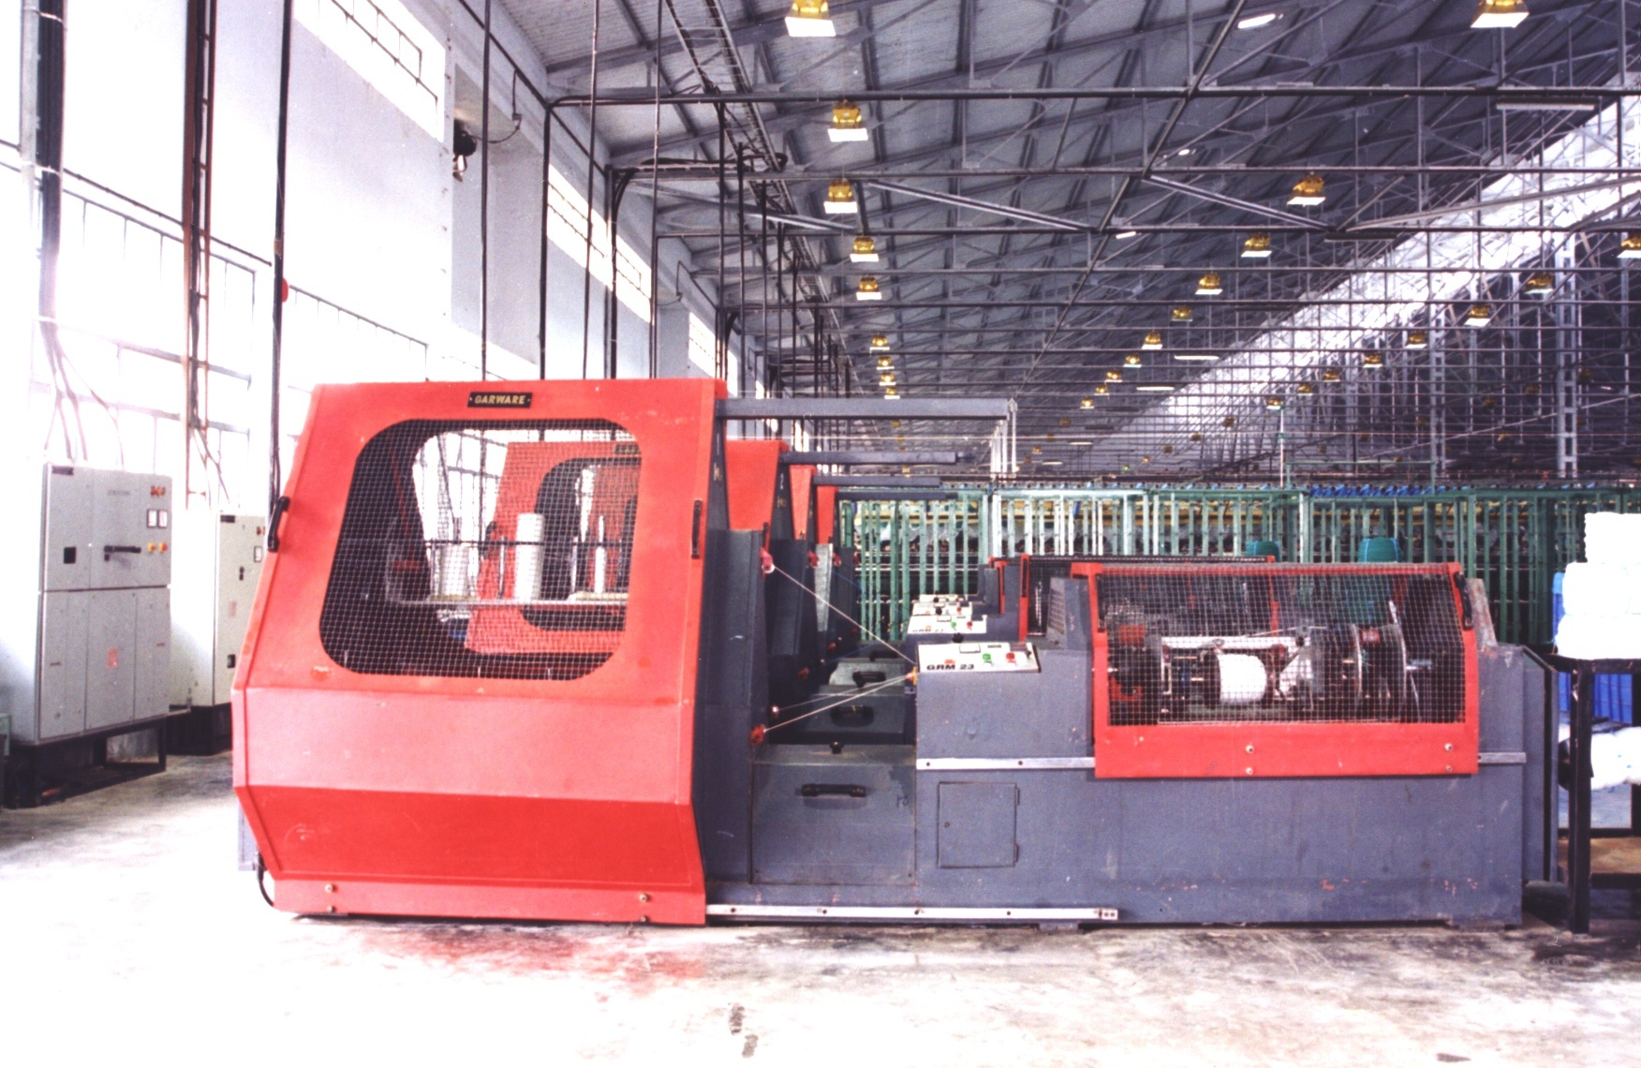
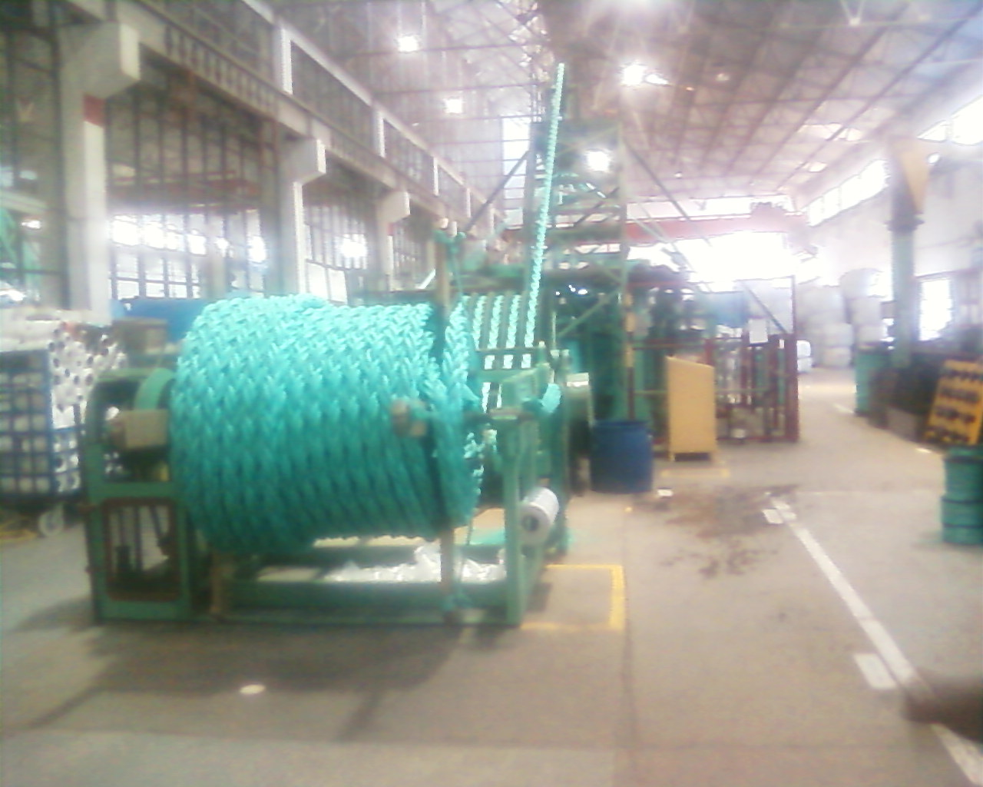
GTFL - Rope Making machines and facilities
3 STRAND ROPE MAKING M/C
8 STRAND ROPE MAKING M/C

Slide 8
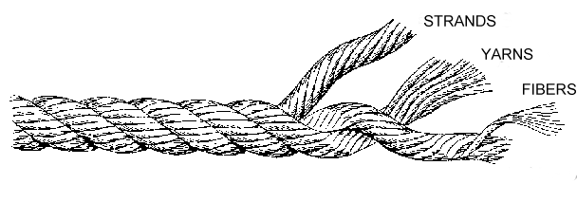
Rope Terminology
Filament/Fiber | Smallest individual element of continuous synthetic material used for rope making
Yarn | A number of fibers twisted together into a length as the first stage of rope making
Strand | A number of yarns twisted together in the opposite twist to the yarn
Twine | Thin cord of two or more strands of yarn
Cord | A number (usually three) strands twisted together with a circumference of 1"(25mm) or less
Rope | Cord of 1"(25mm) or more in circumference

Slide 9
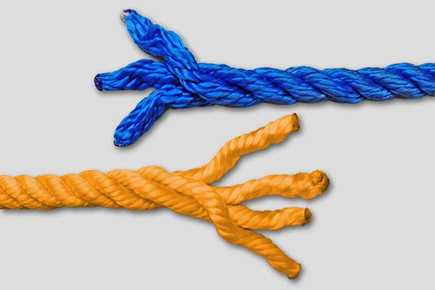
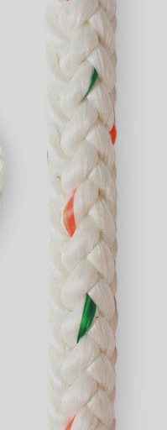
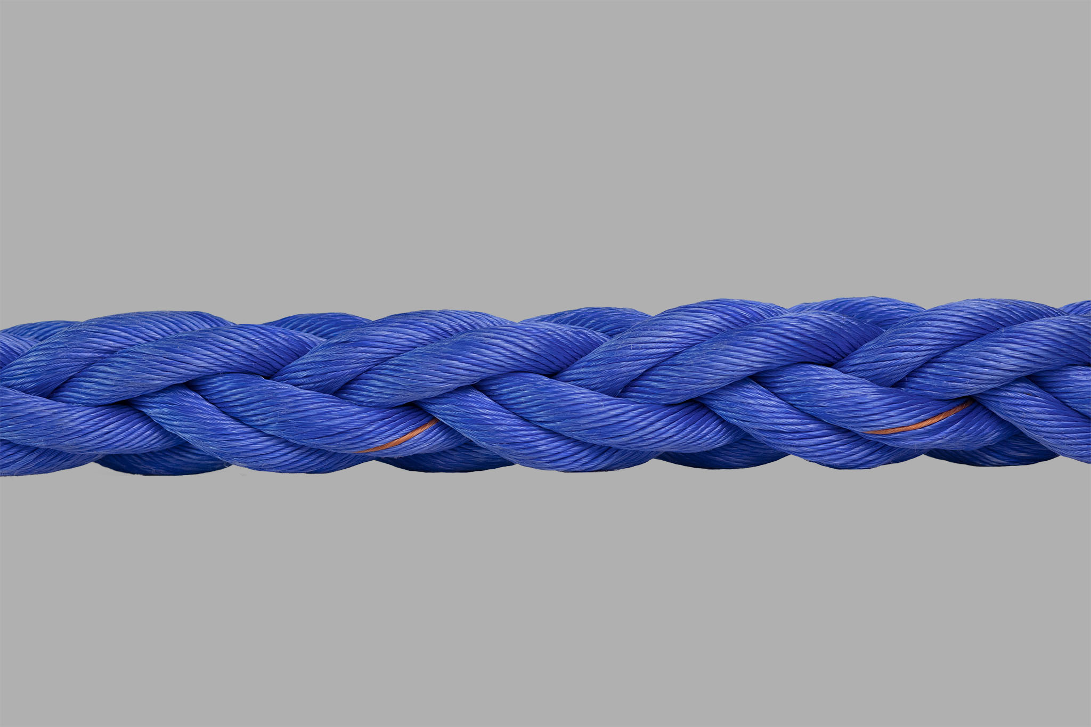
Rope Construction/Types of rope
3- Strand Rope.
4- Strand Rope.
8- Strand Rope.
12- Carrier Rope.
Braid On Braid Rope.

Slide 10
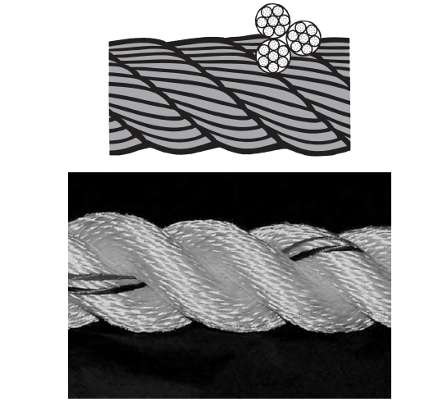
3 strand rope

Slide 11
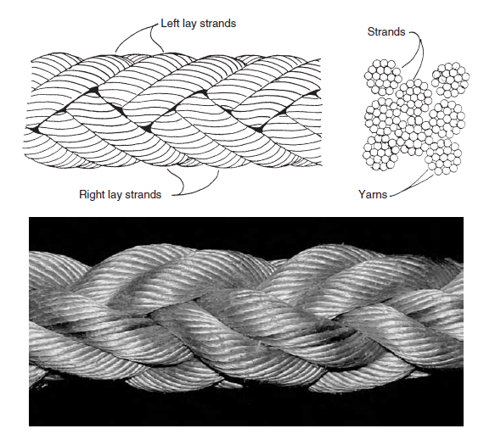
8 strand rope

Slide 12
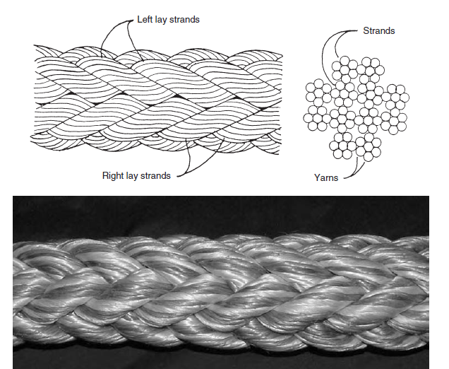
12 strand rope

Slide 13
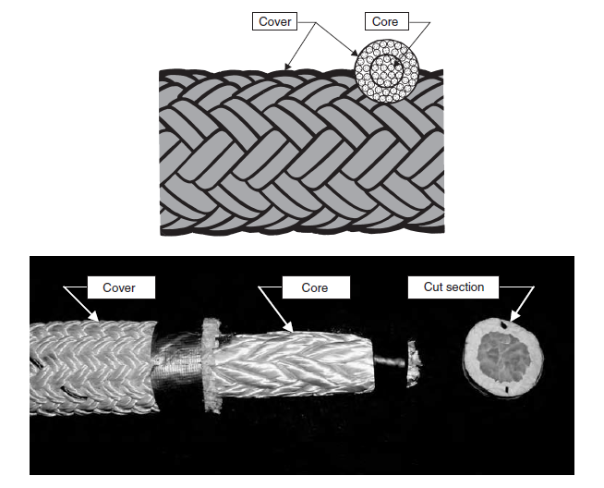
Braid on Braid rope

Slide 14
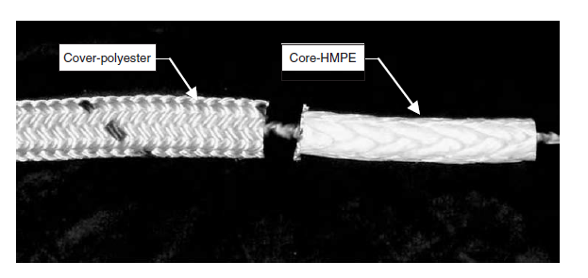
Braided ropes with jacket
An offshoot of double braid is a rope in which a hollow braided or plaited core is used to carry the load, and a braided jacket is used to protect it from external abrasion.

Slide 15
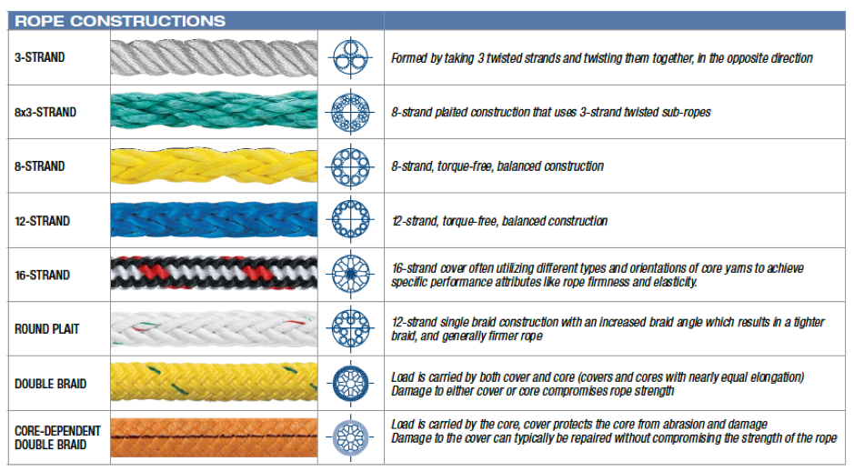
Types of rope
Source: https://www.drillsafe.co.za/drillsafe-articles/what-is-synthetic-rope

Slide 16
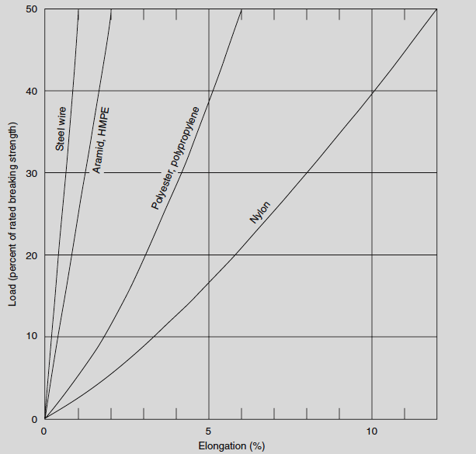
Properties of rope
Breaking load, commonly expressed in kilogram-force, kiloNewtons (102 kgf), tonnes (1000 kgf) or pounds force – It is the minimum load under which rope breaks.
Elongation - All ropes, including wire rope, elongate when loaded. The next most important mechanical property of ropes after strength and low weight is the extent to which they stretch.

Slide 17
Properties of rope
Fatigue- The ability to resist progressive damage from cyclic loading or long term static loading. Ropes that are cycled under load are subject to tensile fatigue.
Creep- The tendency of a material to move slowly or deform permanently under the influence of persistent mechanical stresses. Creep rupture relates to the time to fail under a given load.

Slide 18
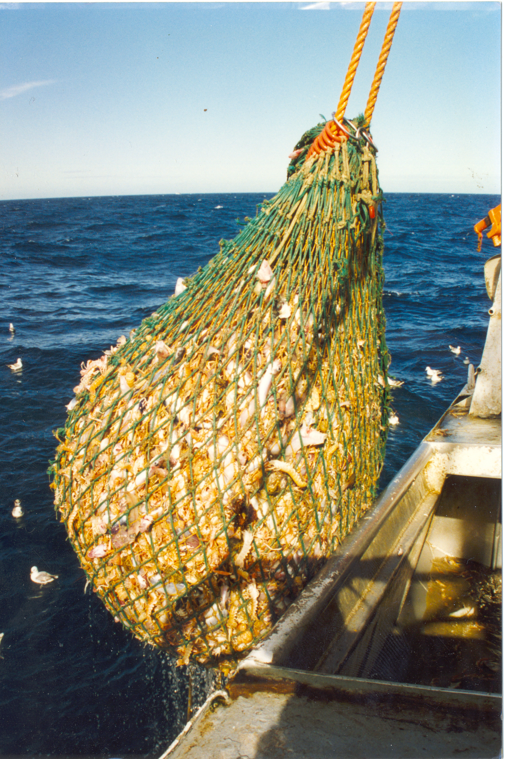
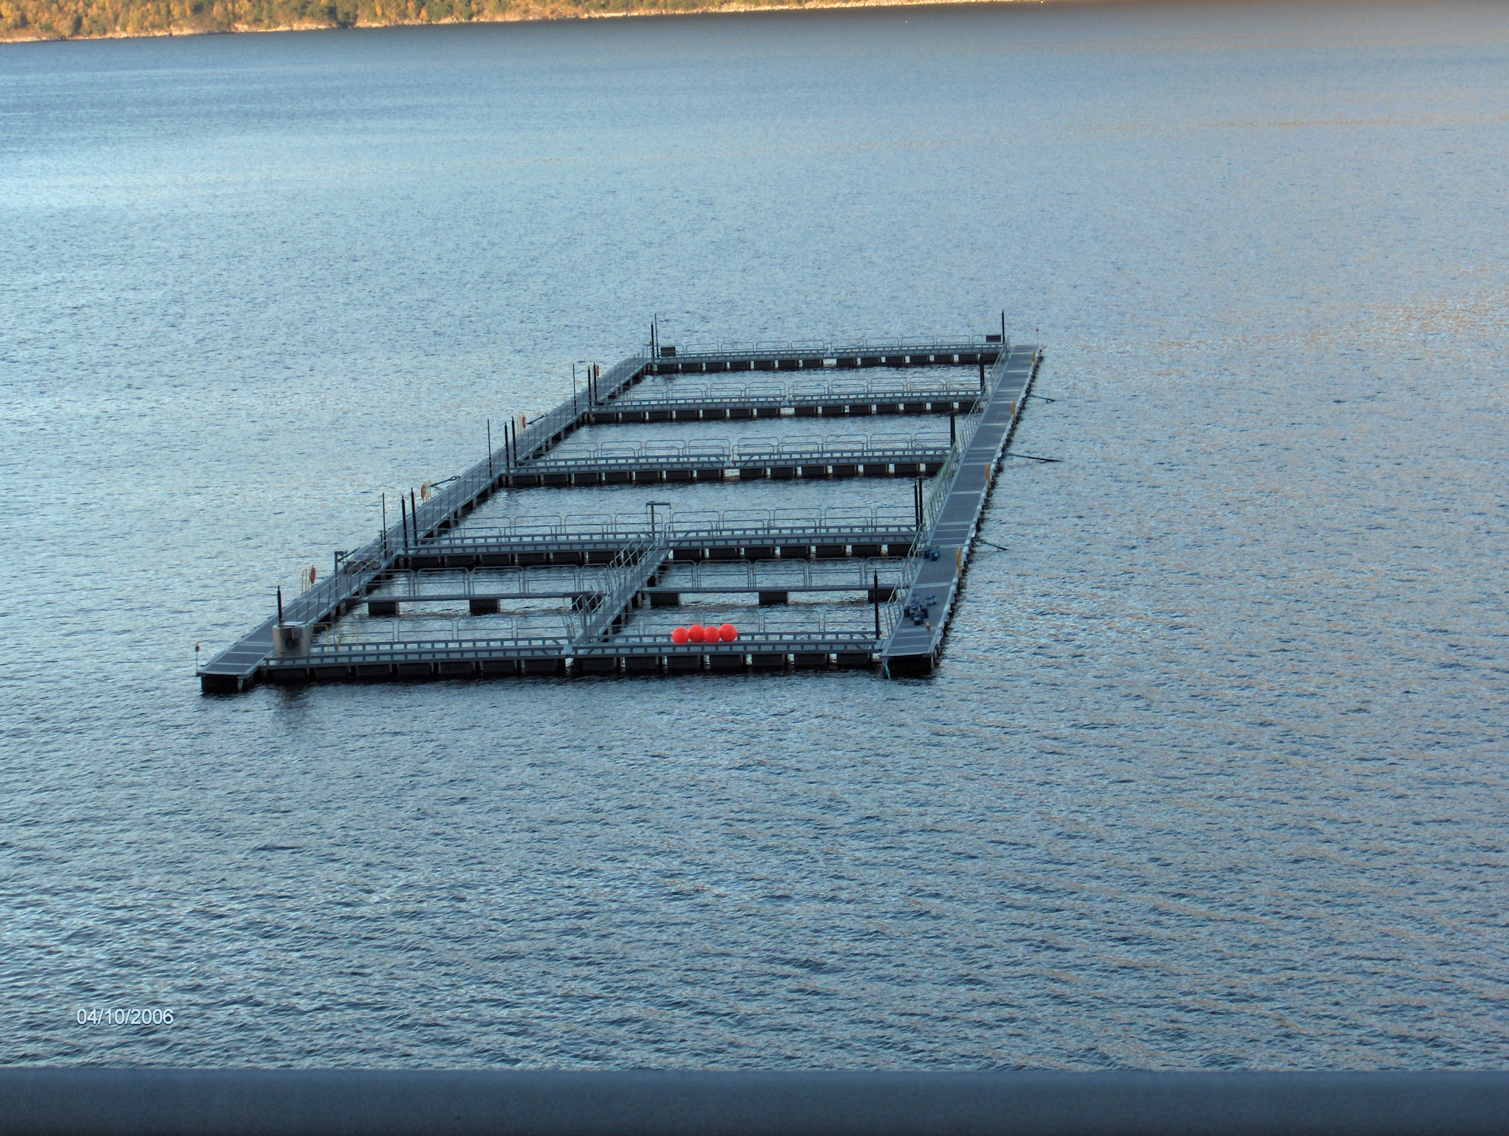
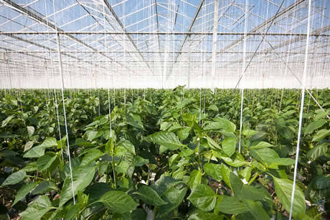
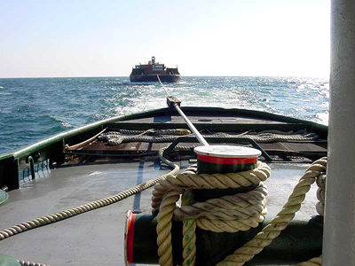
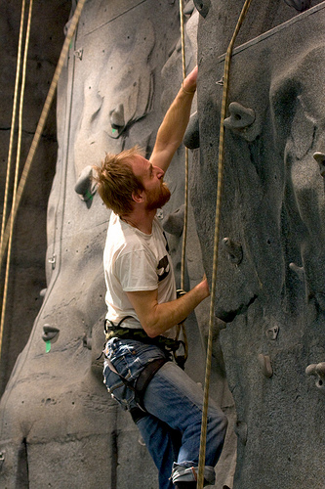
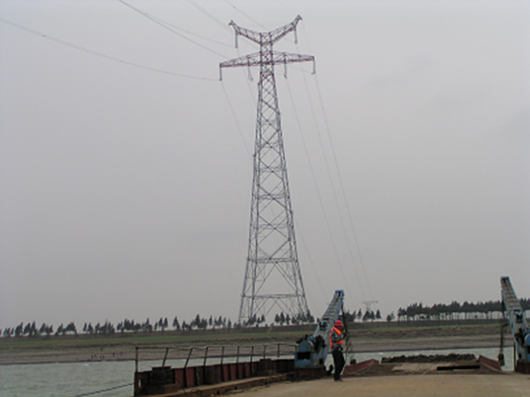
Rope applications
Fishing
Aquaculture
6
1
Agriculture
5
2
Shipping
4
3
Sports.
Industrial

Slide 19
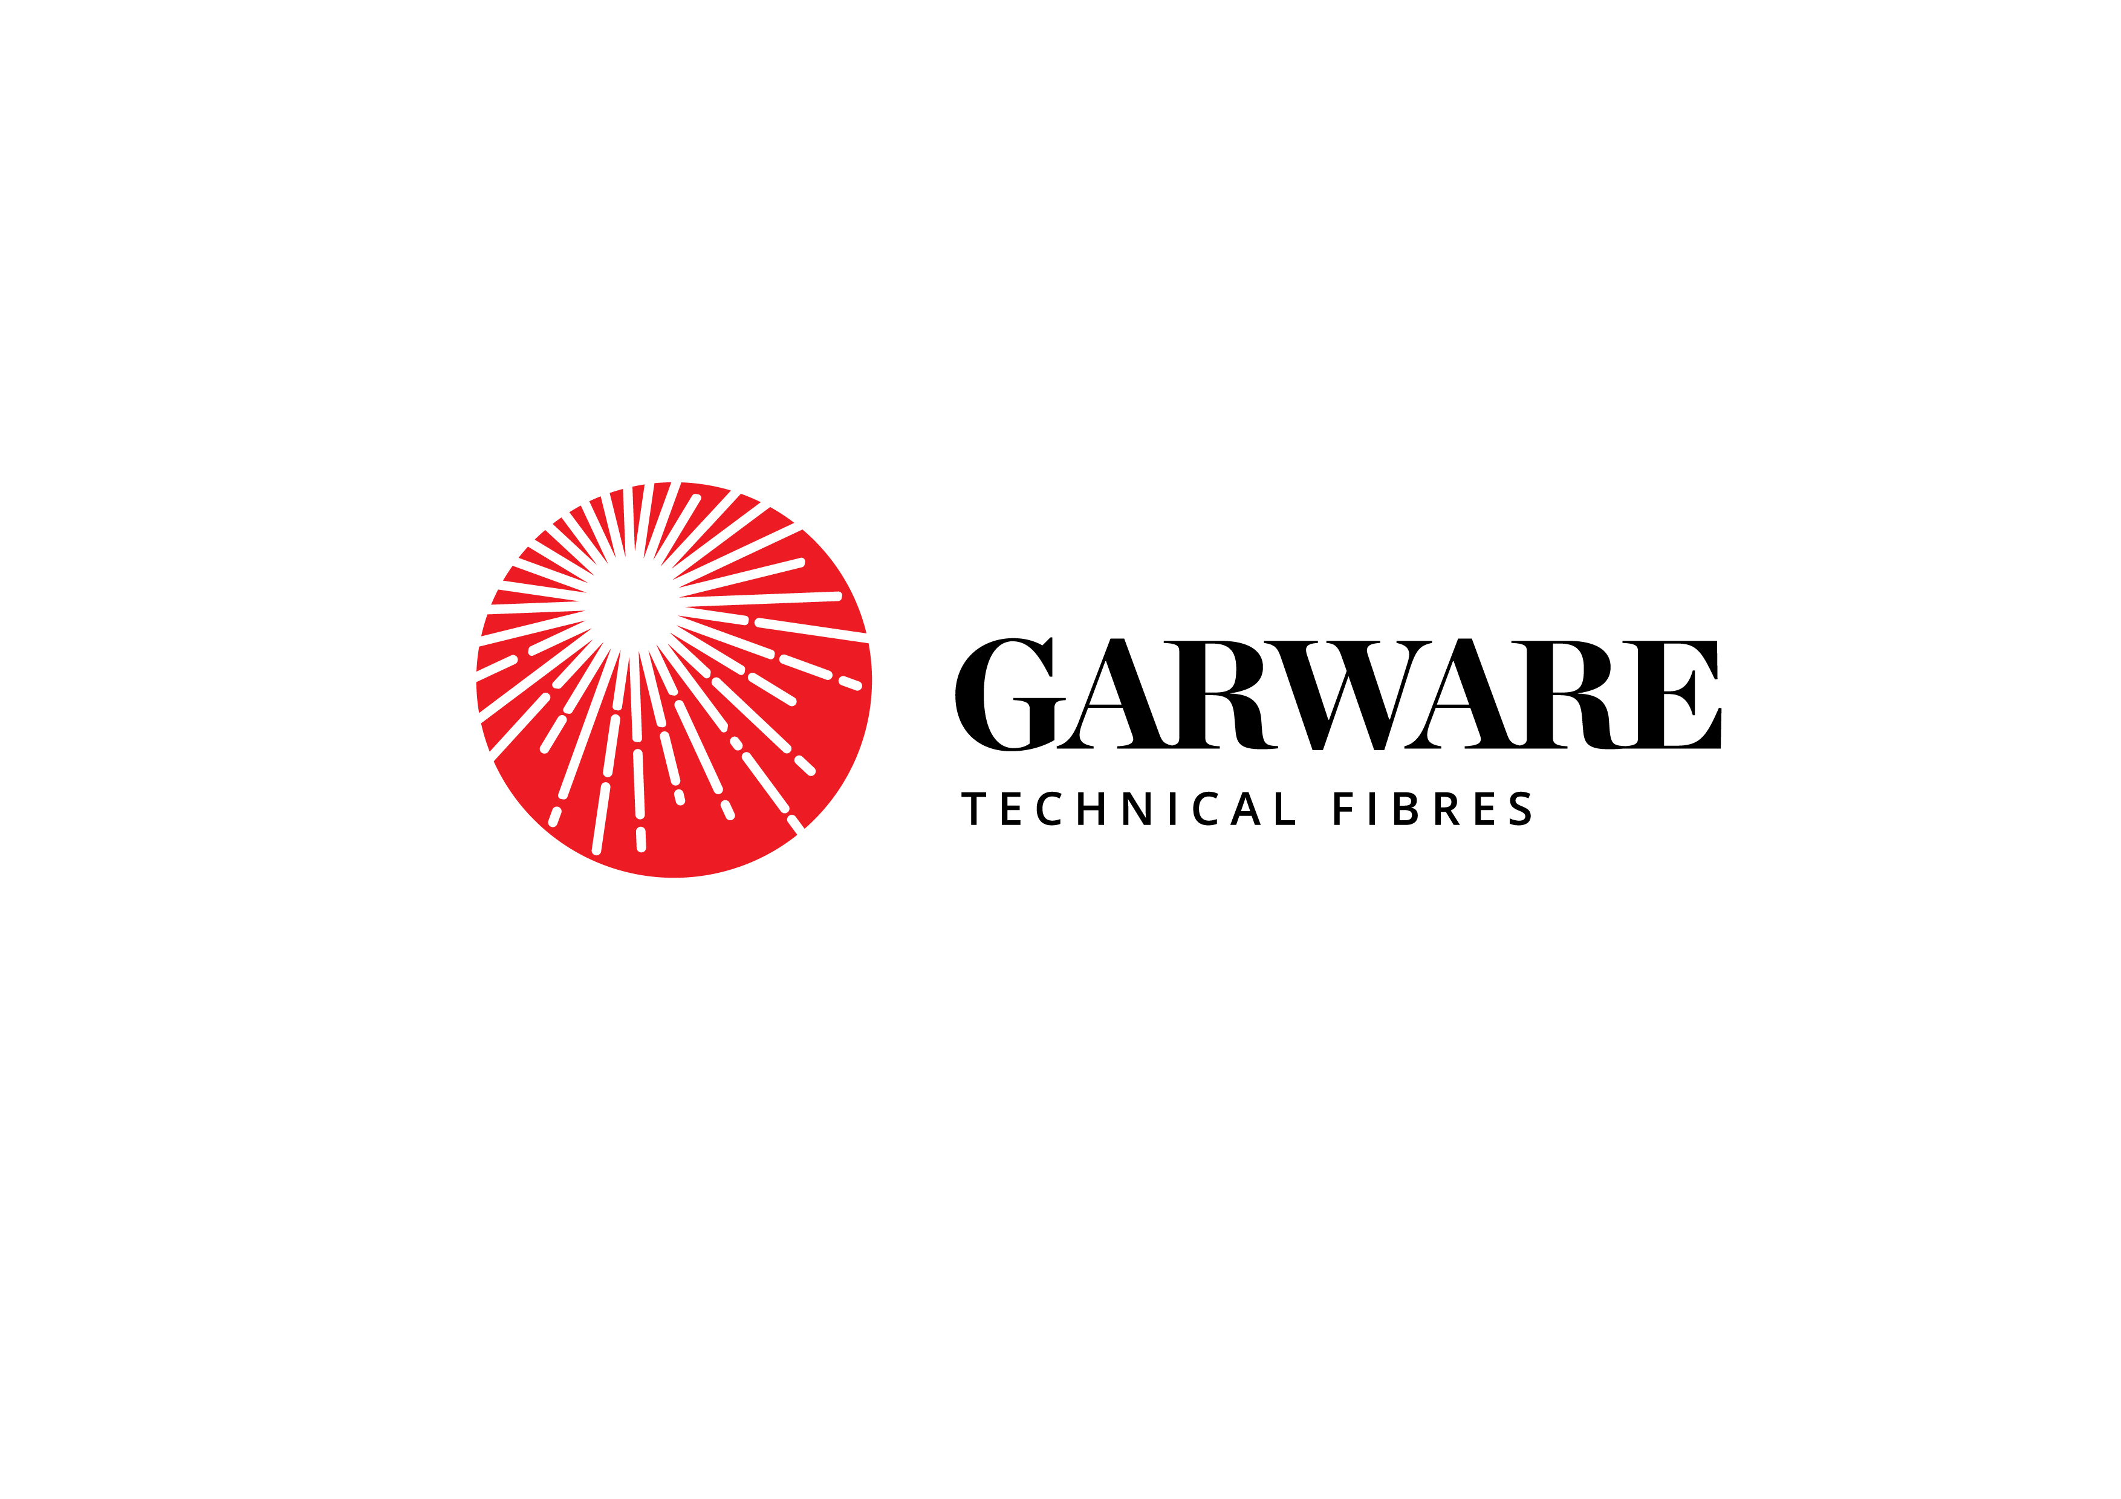
Shipping Ropes

Slide 20
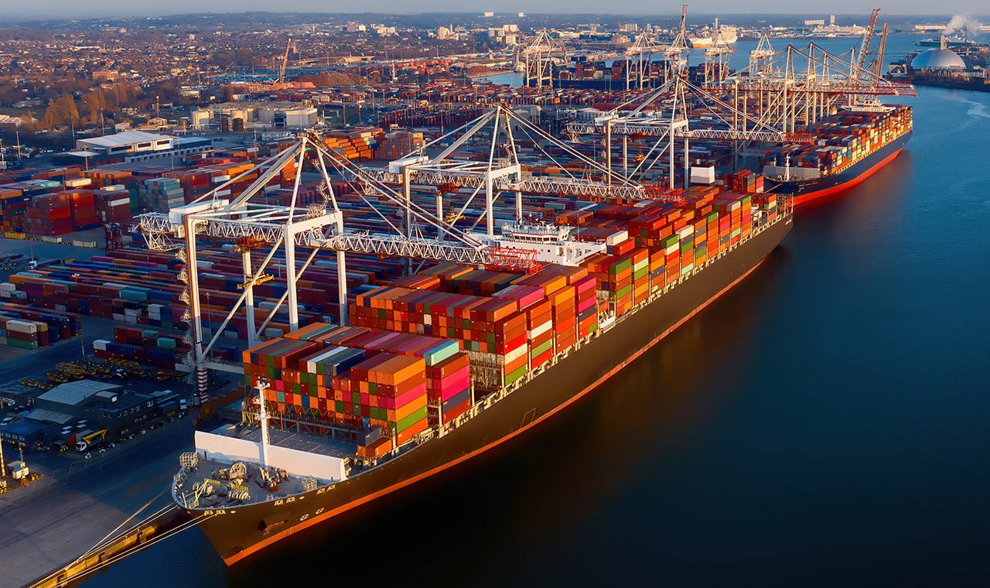
Mooring Operation

Slide 21
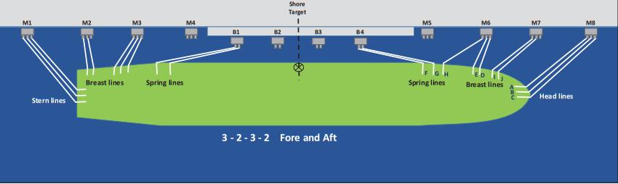
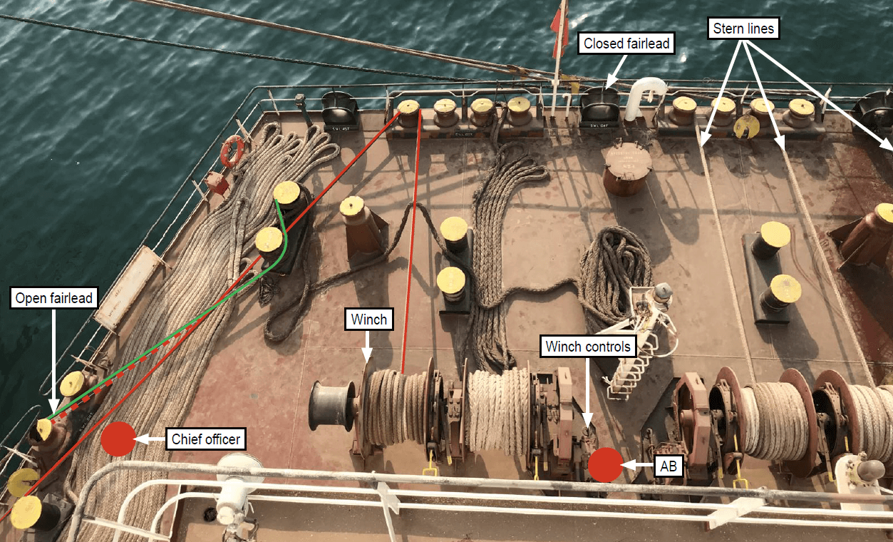
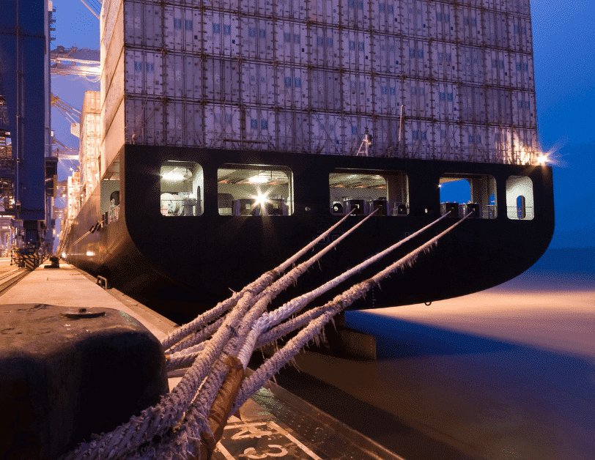
Mooring Ropes

Slide 22

Challenges – Mooring ropes
Weight of ropes should be reduced
Handling of ropes should be easier
Can the bulk be reduced??

Slide 23
8 Strand Ropes –Evolution journey
X2 Neo (2021)
X2 Ultra & Ultima (2016)
X2 Hawser (2013)
Plateena Hawser (2009)
Maxigold Super Hawser (2009)
Maxiflex Hawser (2002)
Maxima Hawser (1998)
Garfil PP Hawser (1983)

Slide 24
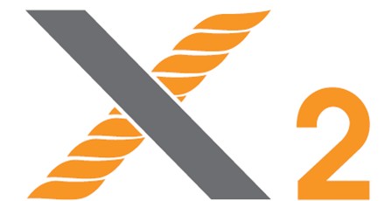
Developments in 8 Strand Shipping Ropes
X2, X2 Ultra, X2 Ultima, X2 Neo
X10 Delayed Snapback
Break Indication (B.I.)
X2 Coated
X2 Low Elongation
Enhancing Safety in Ropes
Providing Higher Abrasion Resistance and Higher Life
Low Elongation in Ropes
X2 Range of Shipping Ropes
X10 Rope
Break Indication Rope
X2 Coated Ropes
X2 Low Elongation Rope
X2
X2 Ultra
X2 Ultima
X2 Neo

Slide 25
X2 & X2 Neo RANGE OF SHIPPING ROPES
DOWNSIZING –
  Reduction in bulk , hence improved handling and reduced fatigue
BETTER TCLL VALUE
  Longer time to retirement, higher value effectiveness
LOW SNAPBACK
  Crew Safety is most important !

Slide 26
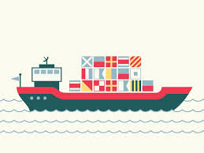

1. DOWNSIZING & EASE OF HANDLING
PP
76 mm
574 kg/220m
68500 kgf
Polysteel
64 mm
407 kg/220m
67500 kgf
X2
60 mm
358 kg/220m
69350 kgf
Lower Diameter of Rope
Better Strength to Weight Ratio
Better Crew efficiency
Ease of handling
Better time utilization
Less Crew Fatigue
Ease of Handling Less Mooring Time Efficiency of Vessel

Slide 27
Strengths Comparison:
Std PP Rope 8 str |  |  | X2 (High strength PP) 8 str |  |  | X2 Neo (Highest strength PP) 8 str |  |  | X2 to std rope | X2 Neo to std rope
Dia. | Linear Density | Breaking Strength | Dia. | Linear Density | Breaking Strength | Dia. | Linear Density | Breaking Strength | BL Ratio | BL Ratio
mm | gm/mtr. | Kgf | mm | gm/mtr. | Kgf | mm | gm/mtr. | Kgf
60 | 1632 | 59500 | 56 | 1417 | 60750 | 52 | 1222 | 58685 | 118% | 132%
64 | 1850 | 67500 | 60 | 1627 | 69350 | 58 | 1520 | 71665 | 117% | 129%
74 | 2459 | 88500 | 68 | 2089 | 89200 | 66 | 1970 | 90300 | 119% | 127%
88 | 3509 | 125000 | 82 | 3038 | 127400 | 78 | 2749 | 127600 | 118% | 130%
96 | 4170 | 148000 | 90 | 3660 | 152450 | 84 | 3188 | 147070 | 117% | 130%
 |  |  |  |  |  |  |  |  | 118% | 131%

Slide 28
Tension Fatigue Testing (TCLL Value)
Tension fatigue occurs in synthetic ropes subjected to fluctuating loads over an extended period of repeated cycles during use.
CYCLES FOR TCLL TESTING
 | Maxima | X2
10 - 50% Load-1000 Cycles | Completed | Completed
10 - 60% Load-1000 Cycles | Completed | Completed
10 - 70% Load-1000 Cycles | Completed | Completed
10 - 80% Load-1000 Cycles (1ST ITERATION) | Completed | Completed
10 - 80% Load-1000 Cycles (2ND ITERATION) | Broke after 138 cycles | Completed
10 - 80% Load-1000 Cycles (3RD ITERATION) | NA | Broke after 317 cycles
TCLL Values | 80.44 | 82.36
It results in degradation of the material and a reduction in the strength of the rope.
TCLL values express the maximum percentage of the breaking strength at which a rope can be cycle loaded 1,000 times.
A higher TCLL Value indicates higher resistance to cyclical tensile loading.

Slide 29
2. HIGHER VALUE EFFECTIVENESS
TCLL Value highest in class
Low Yarn To Yarn Friction
Better Shock absorbance
Ability to withstand cyclic load – highest in its class –
Longer Usage Life Lower Cost of Ownership Lower Operating Cost

Slide 30
X2 Ultima (Floating Mixed Ropes)
The new technologically superior X2 Ultima ropes made from composite Fiber of high tenacity polyester & X2 yarn in a specified composition making it a floating rope.
Technical Specification
Features/Benefits
Material: X2 (75%) & Polyester (25%)
Construction : 8 Strand
Color : Natural White
Elongation @ Break : 18 –20%
Specific gravity : 1.0
MEG 4 complaint
Higher strength to weight ratio
Torque free and balanced construction
Better abrasion resistance
Chemically inert
Excellent shape and original weight retention
Excellent shock absorption capacity, Low snap-back
No loss of breaking strength in wet conditions
Retains flexibility even after prolonged use
Floating rope

Slide 31
Comparison
Std PP Rope |  |  |  | X2 (High Strength PP) |  |  |  | X2 Ultima (High Strength Mixed PP & Polyester Rope)
Dia(mm) | LD(g/m) | BS(kgf) | BL(m) | Dia(mm) | LD(g/m) | BS(kgf) | BL(m) | Dia(mm) | LD(g/m) | BS(kgf) | BL(m)
64 | 1850 | 67500 | 36486 | 60 | 1627 | 69350 | 42636 | 51 | 1490 | 69300 | 46510
72 | 2341 | 84500 | 36097 | 66 | 1968 | 84000 | 42683 | 57 | 1803 | 85000 | 47144

Slide 32
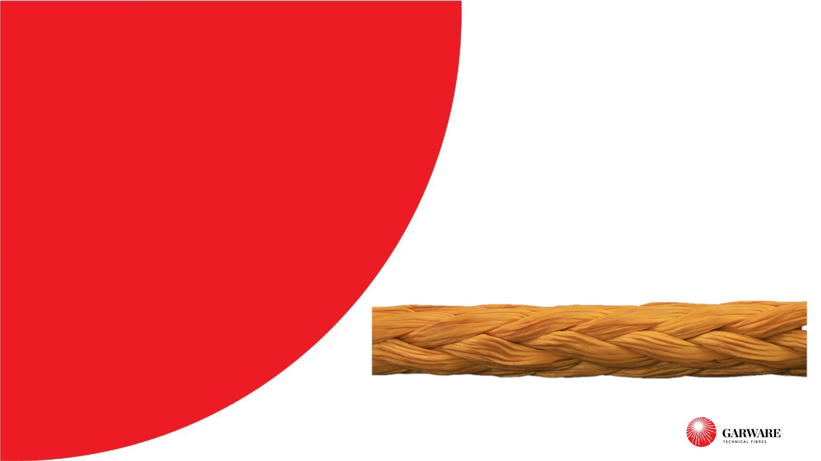
Better Ideas in Action
UHMWPE Ropes
www.garwarefibres.com

Slide 33
UHMWPE– FEATHER LIGHT AS STRONG AS STEEL
One of strongest known synthetic fiber in the world
  As strong as steel wire of the same diameter – BUT 7 TIMES LIGHTER !!!!
  Floats on water
  Extremely durable
High Strength to weight
Safety & Ease of Handling
Increased
Life
Light Weight
Cost of
Ownership

Slide 34
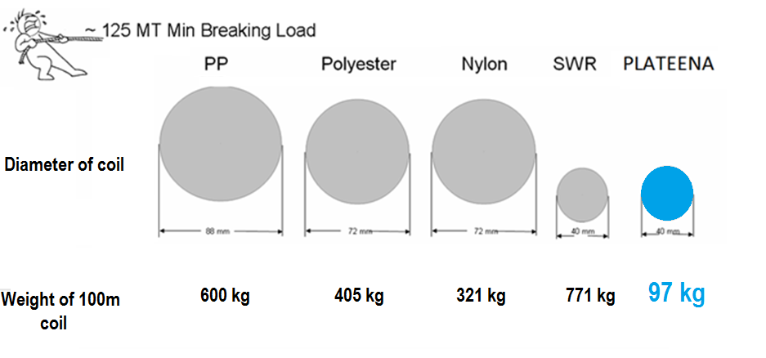
UHMWPE– FEATHER LIGHT ROPE AS STRONG AS STEEL
High Strength to weight

Slide 35
UHMWPE Ropes
Their higher strength to weight ratio makes it easier to handle while operation over the conventional steel wire ropes.
We manufacture UHMPE ropes in 12 strand with a protective jacket.
Technical Specifications
Features / Benefits
Material: UHMPE Fiber
Construction : 12 Strand
Color : Yellow (treated)
− High Strength – Higher strength to weight ratio.
− Lower Weight – Hence easy to handle / Safe
− High Abrasion resistance
− Low elongation at break as compared to Steel Wire ropes. Weight
almost 7-8 time less.
− Excellent Chemical and UV resistance.
− Low Snap Back
− Very High TCLL Value

Slide 36
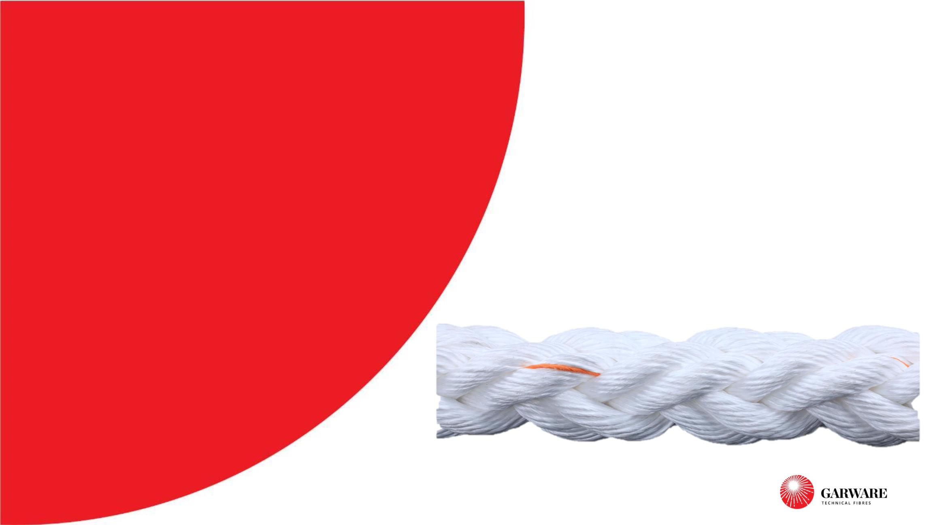
Better Ideas in Action
Safety in Ropes
www.garwarefibres.com

Slide 37
Shipping Ropes –
Delayed Snapback with Break Indication Rope

Slide 38
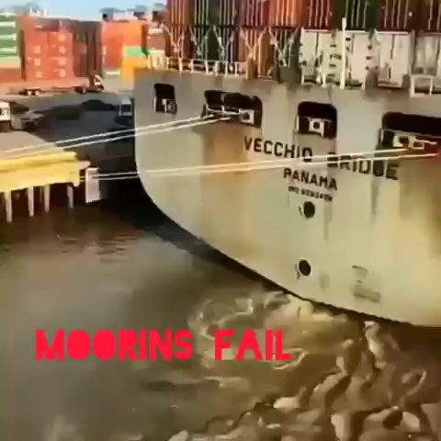
Mooring Operations - Risks
Mooring Operation – Potentially Most Dangerous Marine Activity:
Last 20 years – 58% marine injuries during Mooring Operations
Tankers, Bulk Carriers and Tugs make 50% of Incidents
53% due to Rope Parting…!!! Snapback of mooring line causes serious injury
  1:4 chance of Leg injury or limb loss,
  1:7 chance of back injury
  1:7 chance of death
Need for Rope with enhanced safety features

Slide 39
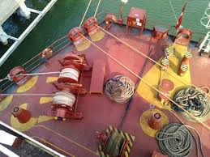
Mooring Operations - Risks
Solutions Offered:
To reduce the impact of Parting Mooring Rope (X10 Rope)
To help in evaluation of wear and tear in rope for right time retirement (Break Indication Rope)

Slide 40
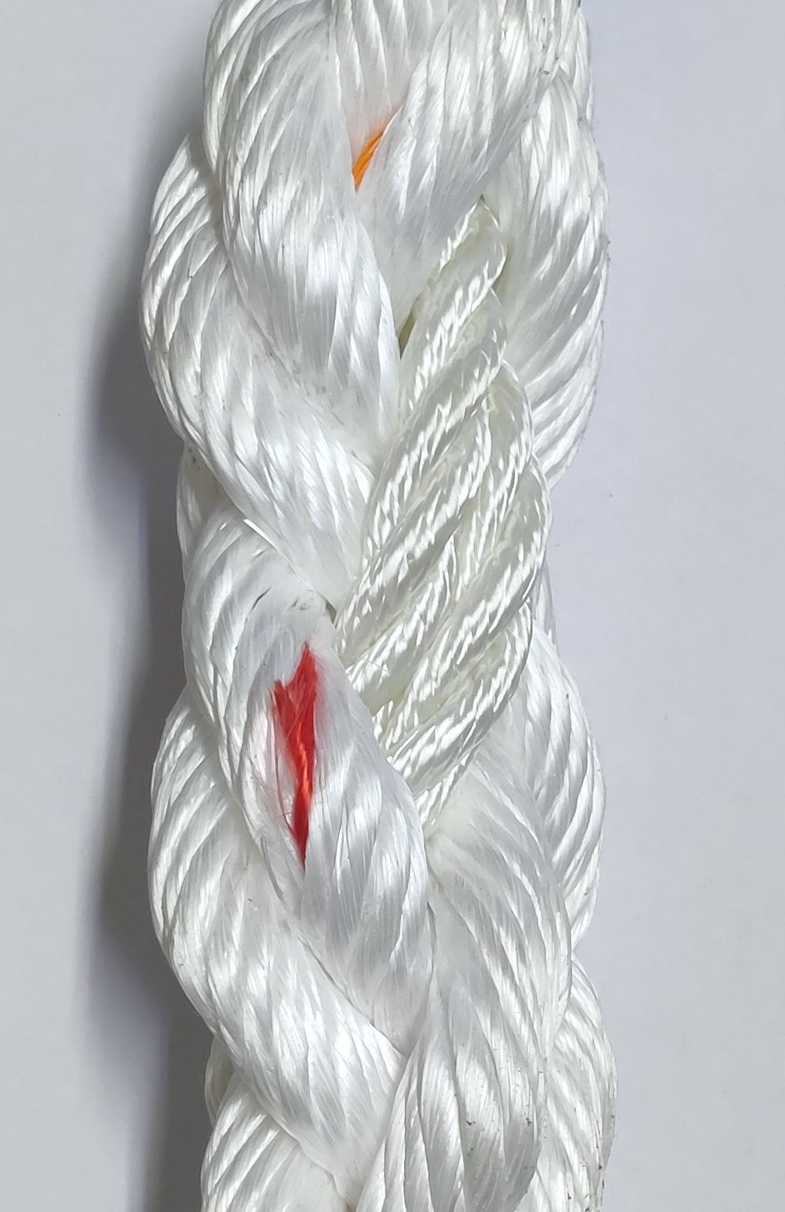
1. X 10 & BI Rope – Delayed Snapback Rope
Specially designed rope to enhance Safety on Board!!
RRS Component for delayed snap back
On-board safety
Indicator for external wear
X10 + BI Rope
Delayed Snapback
Rope Strength
Break Indicator for external wear and tear detection
X10 + BI rope will reduce probability of such accidents

Slide 41
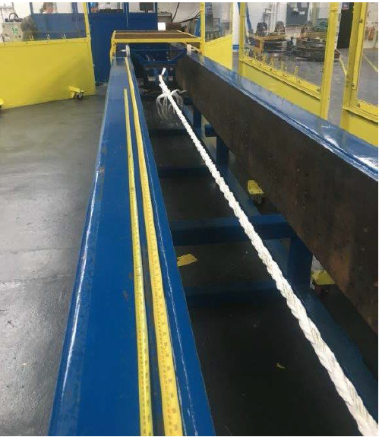
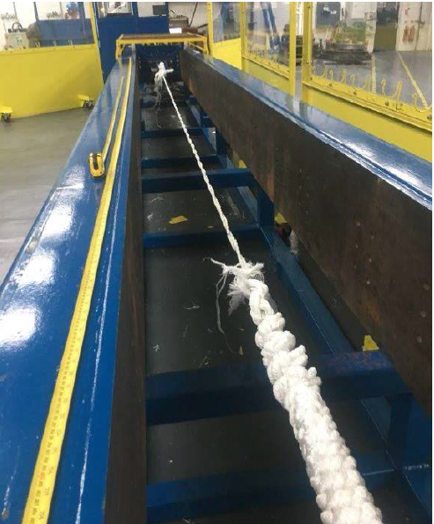
1. X 10 – Delayed Snapback Rope
Proven by Testing at Tension Technology International (TTI), UK as per CI 1502-12
At loading rate of 3 mm/sec (similar to mooring condition),
Sufficient time of more than 4 minute for crew to move away when they hear a sound/spot initial breakage from the rope.
RRS component
Sample before break
Sample after first break

Slide 42
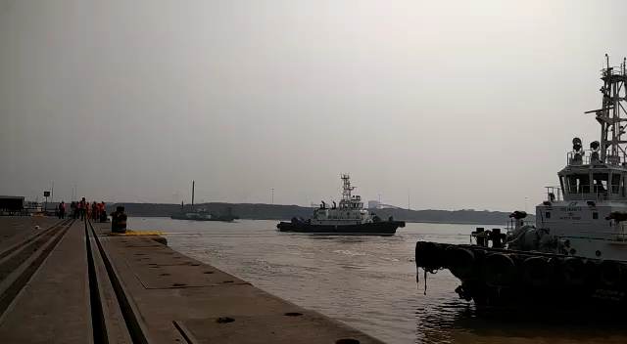
X 10 – Delayed Snapback Rope
*Bollard Pull Test performed with propeller loading rate of around 3.5 to 4 meter per second (*This is an extreme case of high speed for a Mooring rope performed only for demonstration purpose).
Sufficient time for crew (~6 sec) to move away when they hear a sound / spot initial breakage from the rope
More confident crew during mooring operation
Prior Warning Indication Enhanced Safety

Slide 43
Better Ideas in Action
Towing Ropes
www.garwarefibres.com

Slide 44
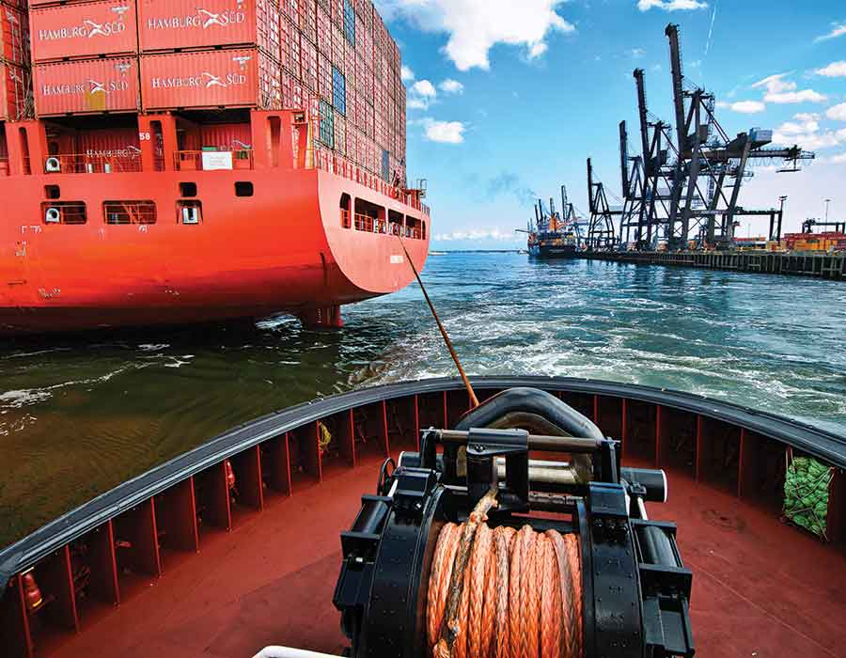
Towing Operation

Slide 45
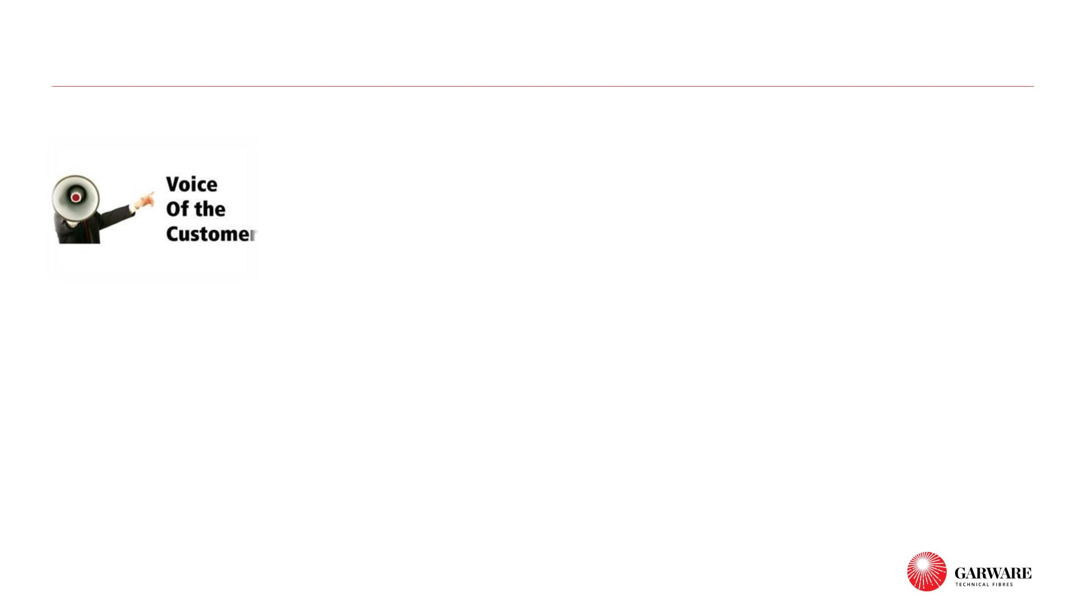
What could we do to enhance Towing operations ?
❑ Weight of ropes should be reduced !
❑ Handling of ropes should be easier
❑ Can the bulk be reduced??
❑ Can you enhance the movements per coil before retirement ?
❑ Can you develop a rope retirement criteria or inbuilt safety
features ?
3

Slide 46
Better Ideas in Action
X2 Ultra ropes

Slide 47
X2 Ultra Ropes (Sinking Mixed Rope for Towing Application)
The new technologically superior X2 Ultra ropes made from composite Fiber of high tenacity polyester & X2 yarn in a specified composition for the towing purpose.
Technical Specifications
Features / Benefits
Material: X2 (50%) & Polyester (50%)
Construction : 8 Strand
Color : Natural White
Elongation @ Break : 18 – 20 %
Specific gravity : 1.13
MEG 4 complaint
✓ Downsizing
20% REDUCTION IN ROPE BULK FOR SAME STRENGTH
▪ Easier handling for crew
▪ Reduced load on winches and capstans and thus reduced wear
▪ Better rope at same coil price
✓ Better TCLL value - Increase in operational life
▪ Class leading TCLL value
▪ TCLL cycles for X2 Ultra is more than 2.5 times Maxiflex
▪ Higher TCLL imply twice number of movements before rope retirement
✓ Lower Snapback
• Crew Safety is most important!

Slide 48
X2 ULTRA ROPES FOR TOWING
FLEX ROPE |  |  | X2 ULTRA ROPE |  |  | % DIFF.
Dia | Wt./m | BS | Dia | Wt./m | BS
64 | 2.25 | 82600 | 58 | 1.84 | 83000 | 18.2
80 | 3.52 | 125500 | 72 | 2.85 | 126000 | 19.1
85 | 3.97 | 140000 | 78 | 3.35 | 145000 | 15.8
18% ADVANTAGE OVER FLEX Ropes

Slide 49
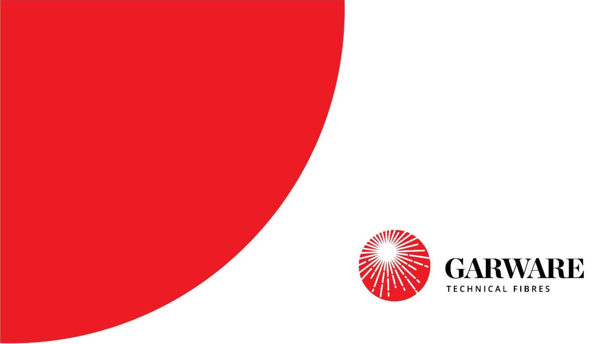
Better Ideas in Action
HMPE Soft Shackle

Slide 50
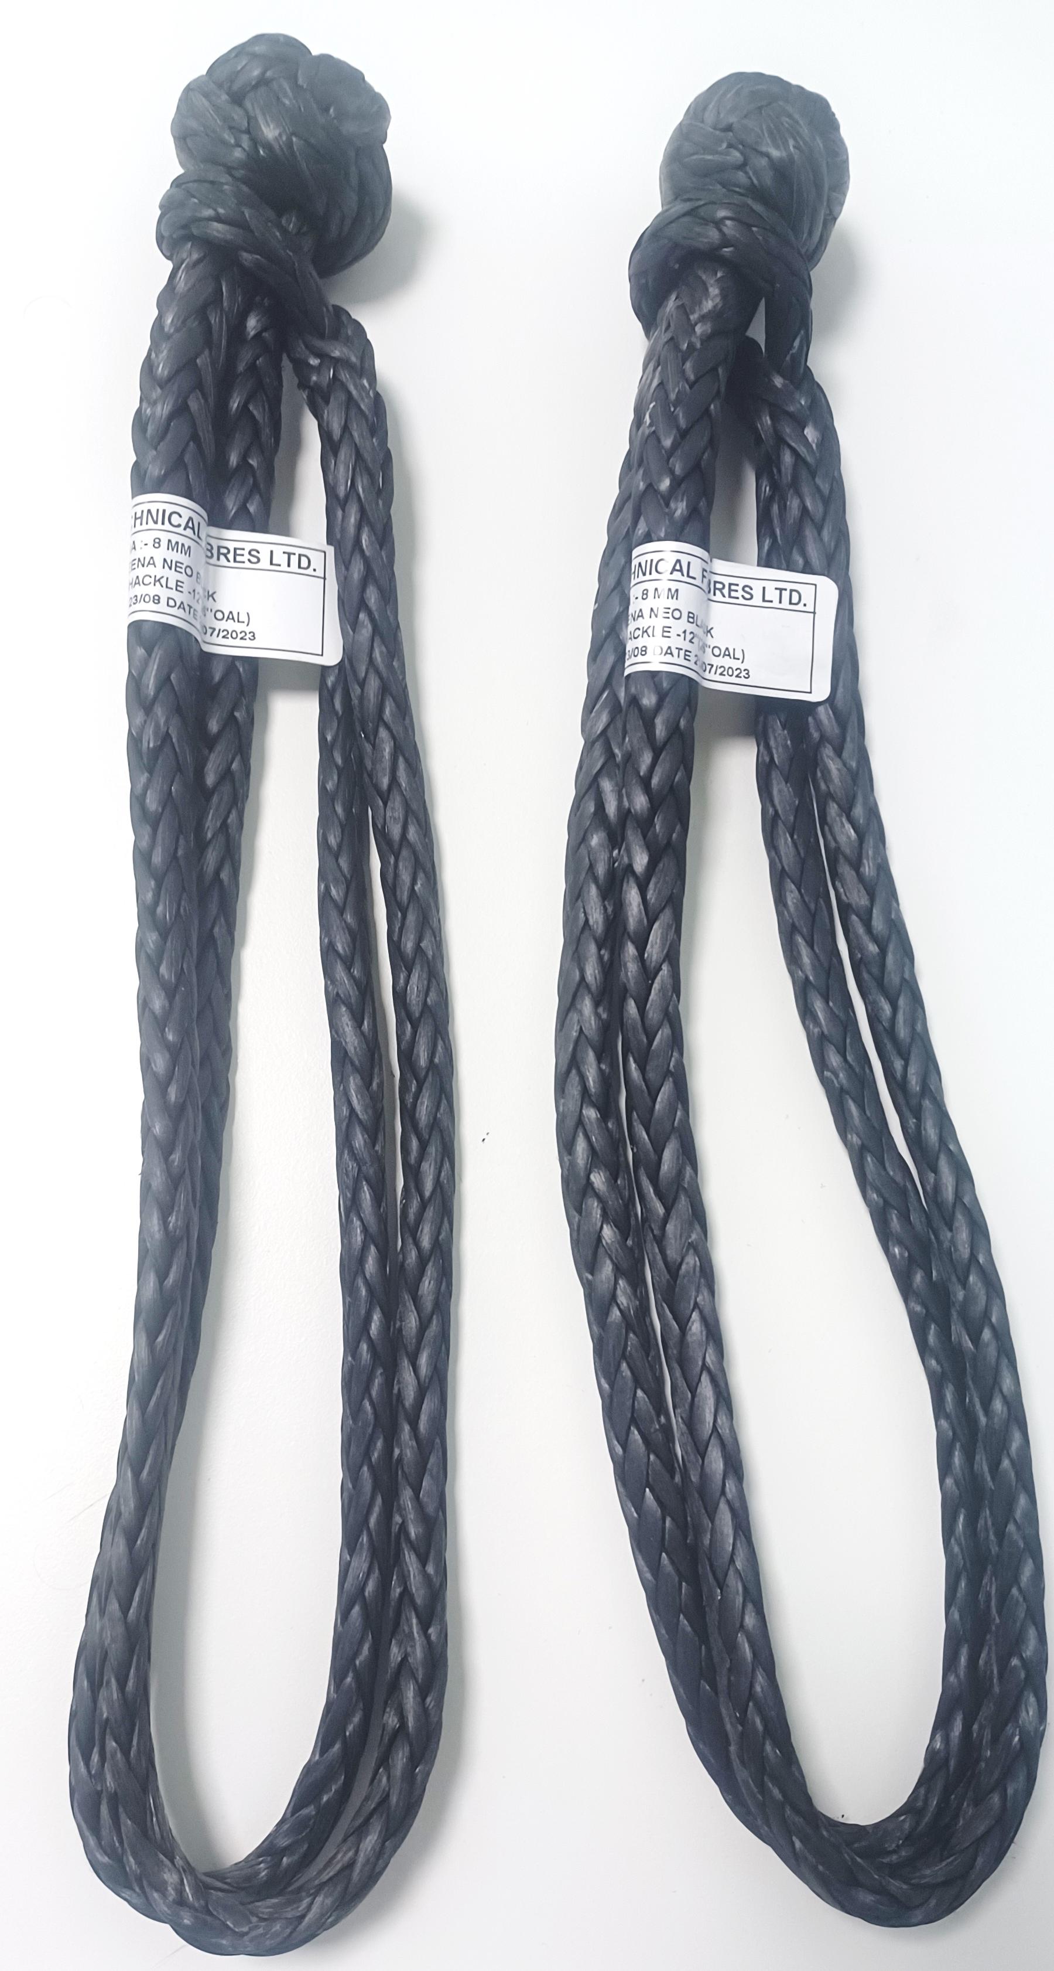
HMPE Soft Shackle (Alternative to the metallic shackles)
Made with HMPE, the soft shackles are a replacements of the metallic shackles and carabiners which are easy to carry and install.
Technical Specifications
Features / Benefits
Material: UHMPE Fiber
Construction : 12 Strand
− High Strength – Higher strength to weight ratio
− Lower Weight – Hence easy to handle / Safe
− Weight almost 7-8 time less.
− Excellent Chemical and UV resistance.
− Low Snap Back
− Very High TCLL Value

Slide 51
Better Ideas in Action
Synthetic Towing Assembly

Slide 52
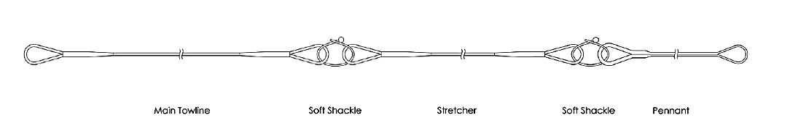
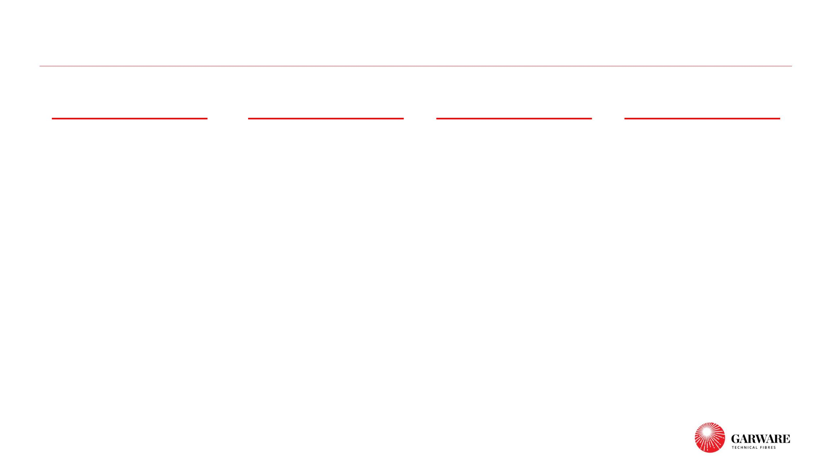
Synthetic Towing Assembly
Towline
Stretcher
Soft Shackle
Pennant
Plateena NEO
(UHMPE )
X2 Ultra
Plateena NEO
(UHMPE )
Plateena NEO
(UHMPE )
A composite Fiber of high tenacity
polyester & X2 yarn with better
UHMPE make shackle with
stronger & lighter compared with
steel.
High performance fiber facilitating
highest strength , lighter weight to
withstand the towing connection
Their higher strength to weight
ratio makes it easier to handle
while operation over the
shock absorption capacity and low
snapback.
conventional steel wire ropes.
X2 Ultra
Nylon
A composite Fiber of high tenacity Conventional nylon stretcher with
polyester & X2 yarn with reduce
coil recall and better abrasion
properties.
higher elongation and shock
absorption.
4

Slide 53
Better Ideas in Action
Future Developments in Shipping Rope

Slide 54
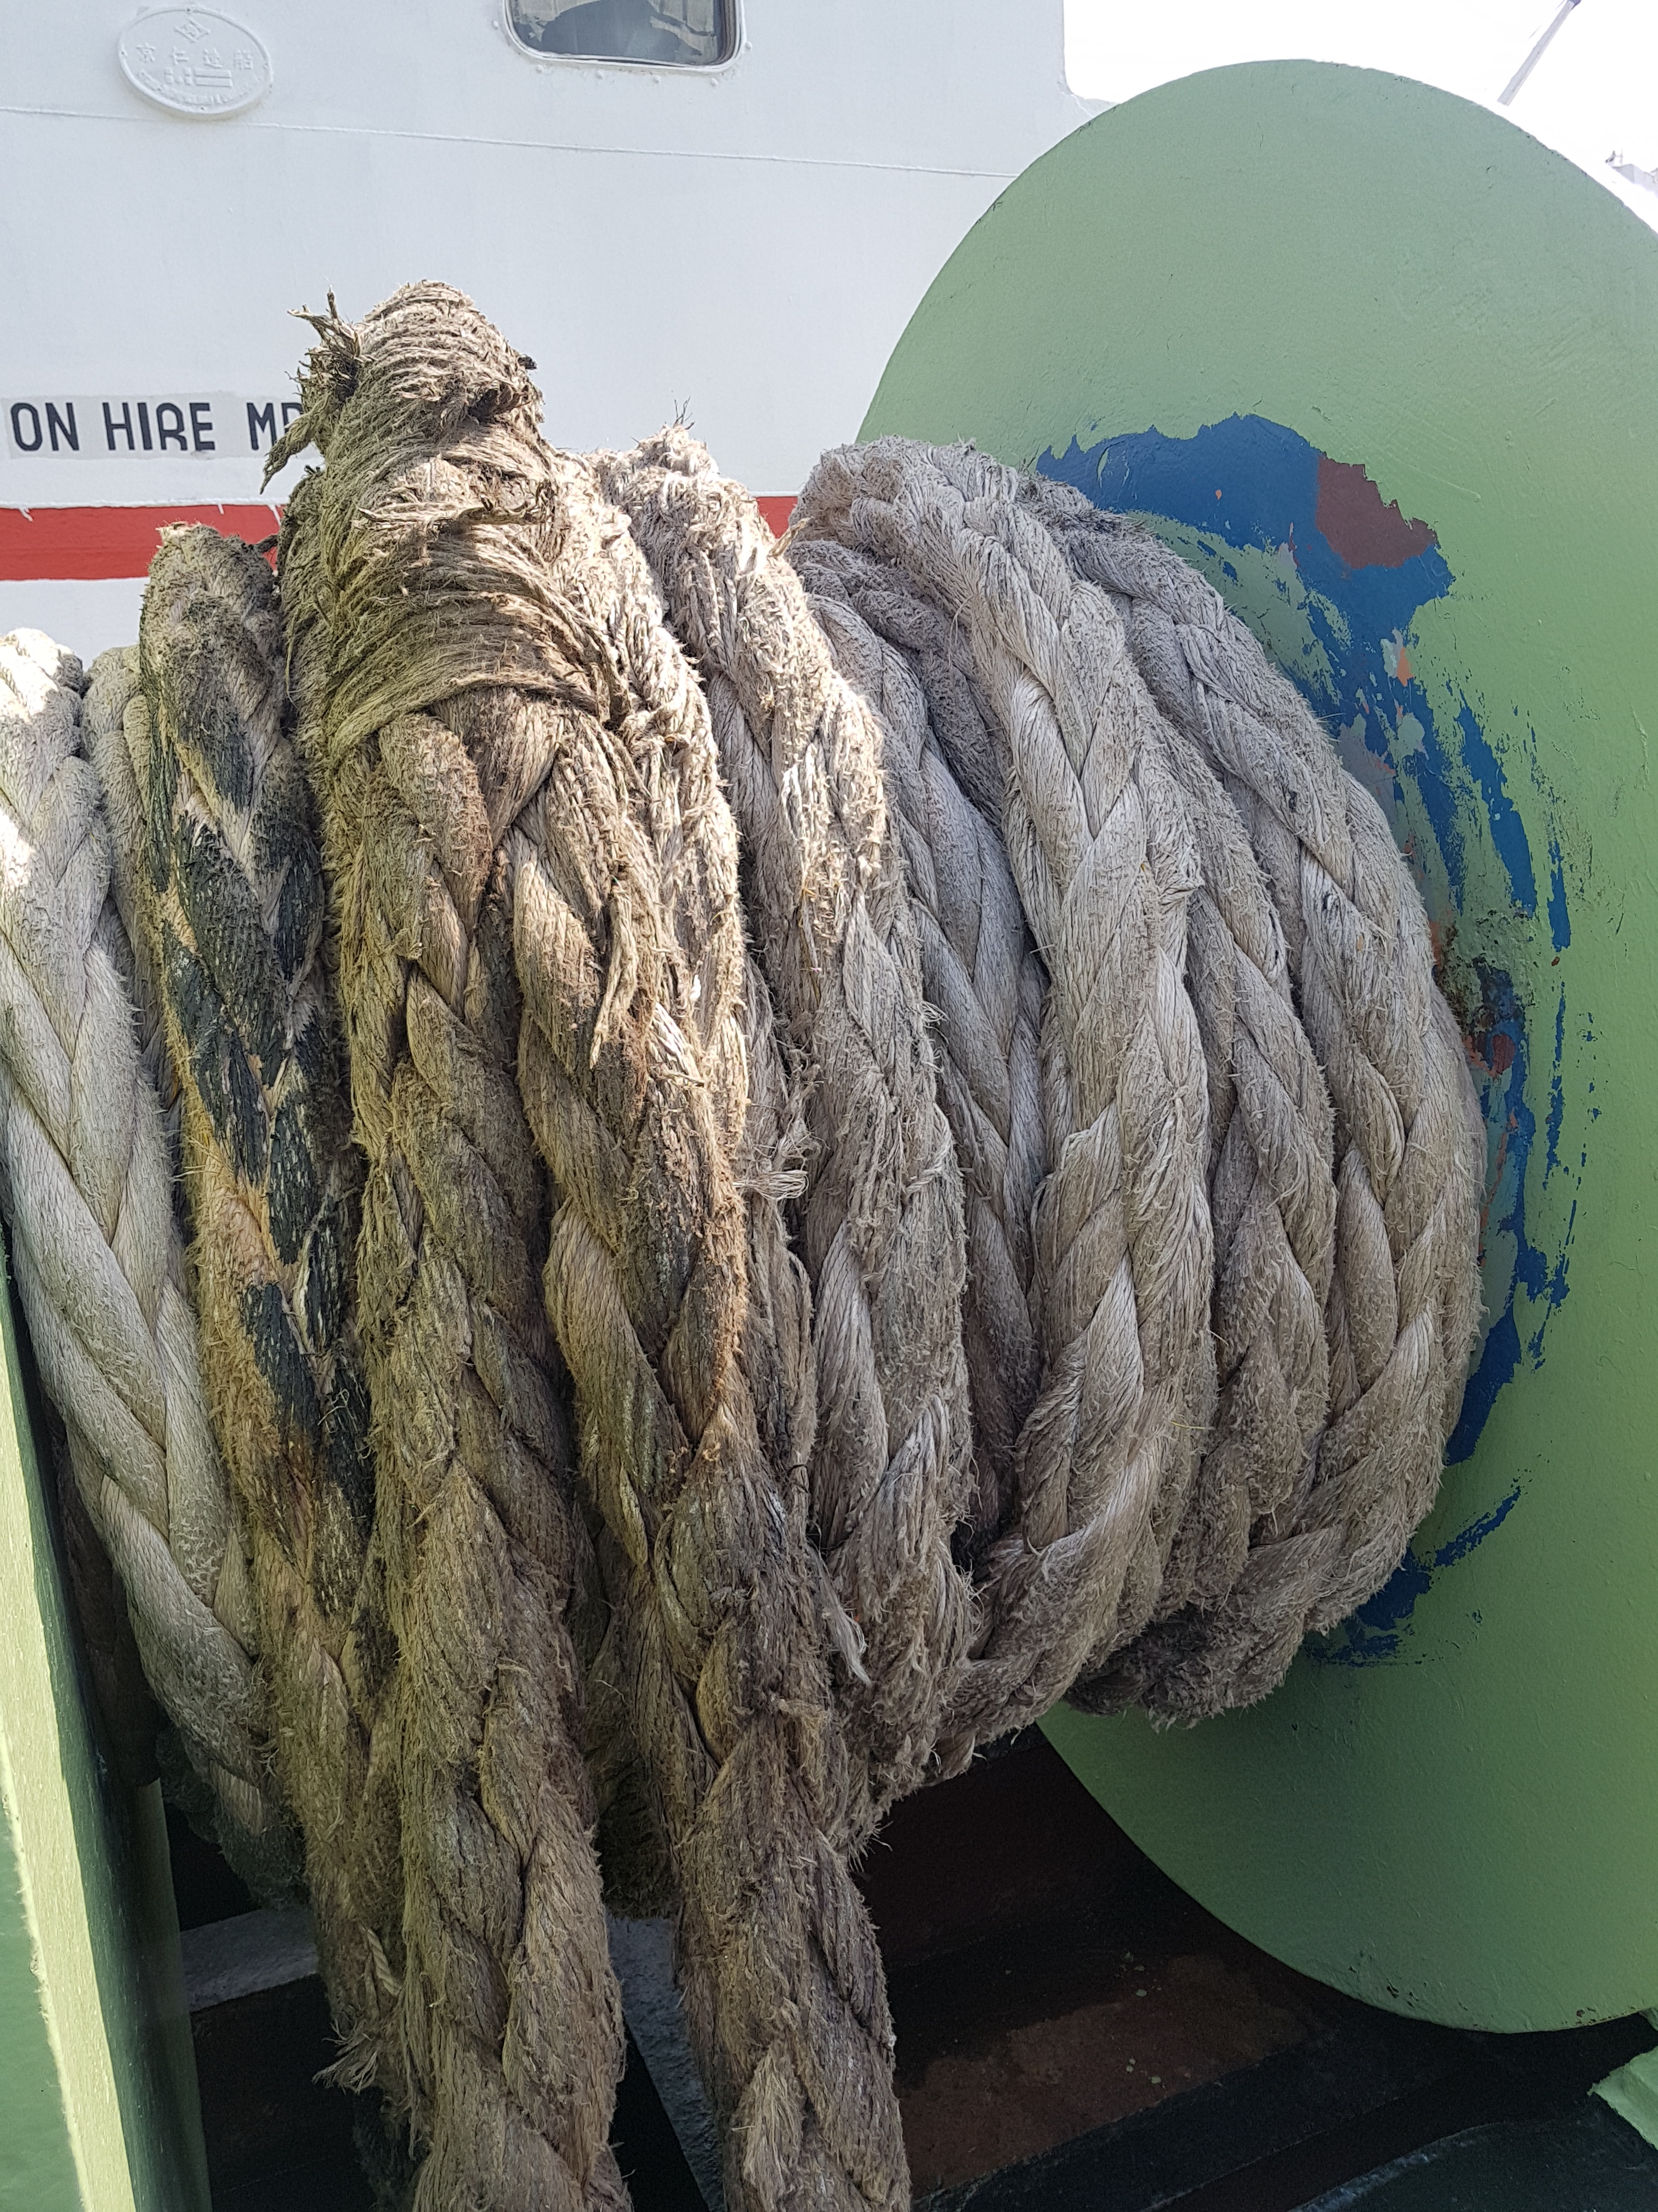
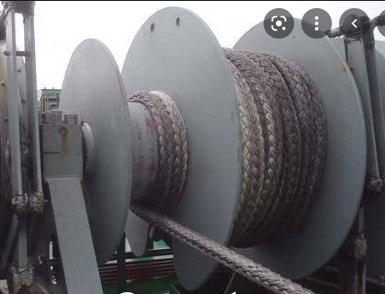
To enhance Operational life in Shipping Ropes
Major Issues affecting life of rope –
1. Abrasion in rope due to contact with external surfaces
2. Degradation of rope due to bending fatigue
Notes:
Wet Abrasion resistance of Nylon is very poor as compared to HDPE. This can result in holes being formed in Nylon netting.
Multifilament yarn like Nylon will have lower abrasion and cut resistance due to filamentation, which breaks the individual filaments during abrasion

Slide 55
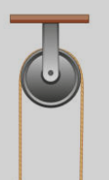
Bending Fatigue in rope
Bending Fatigue is induced when the rope under tension is bent and cycled over the rotatable curved surface.
It plays a considerable role in deciding the life and performance of rope especially when used over winches/pulleys/sheaves
Bending Fatigue Tests covered in MEG4, Cordage Institute and DNV standards
Notes:
Wet Abrasion resistance of Nylon is very poor as compared to HDPE. This can result in holes being formed in Nylon netting.
Multifilament yarn like Nylon will have lower abrasion and cut resistance due to filamentation, which breaks the individual filaments during abrasion

Slide 56
X15 Ropes
Working on Next generation Rope Development with significant improvement in
Abrasion Resistance of rope – 50% improvement over X2
Bending Fatigue of rope – 100% improvement over X2
*Normalized to a scale of 100 for X2

Slide 57

Renew Ropes
Features | Benefits
Sustainability | Ropes made from 100% Recycled Products
Strength | No compromise, Same strength as Maxima Ropes (Danline type of ropes)
Fatigue Properties | Same as Maxima Ropes (Danline type of ropes)
Abrasion Properties | Similar as Maxima Ropes (Danline type of ropes)
Spliceability | Easily spliceable
Colour | Available in Black colour
Type | Available in both 8 strand and 3 strand

Slide 58

Thank You

